Slide 1
IP address
input
Port
input
Connect
Google map view
This view shows the incoming lat/long on map
Connection Status
Subscribe
Topic name to Subscribe from
Subscribe
Subscribed topic output
Publish
Topic name to publish on
Payload to publish
Publish

Slide 2
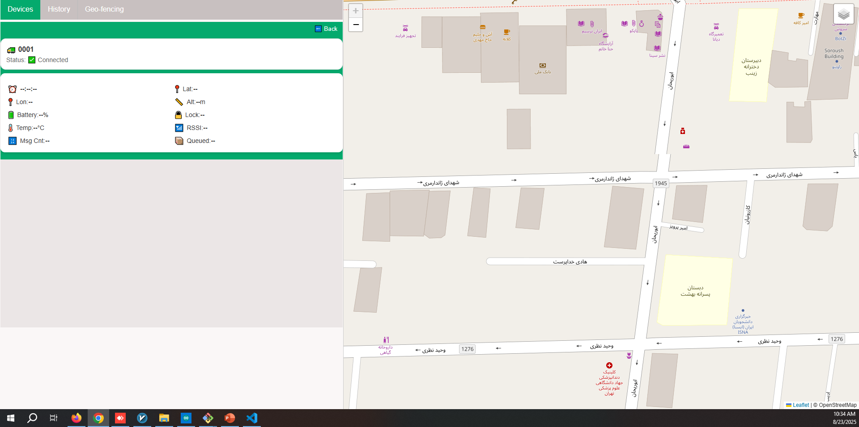






d
Time: --:--:--
Latitude: -
Longitude: -
Lock status
Battery: --%

Slide 3




d
Time: --:--:--
Latitude: -
Longitude: -
Lock status
Battery: --%

